Slide 1

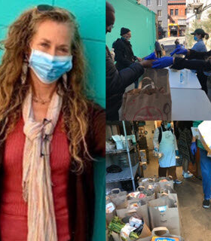
North Beach Citizens Overview
Demographics and Statistics

Slide 2
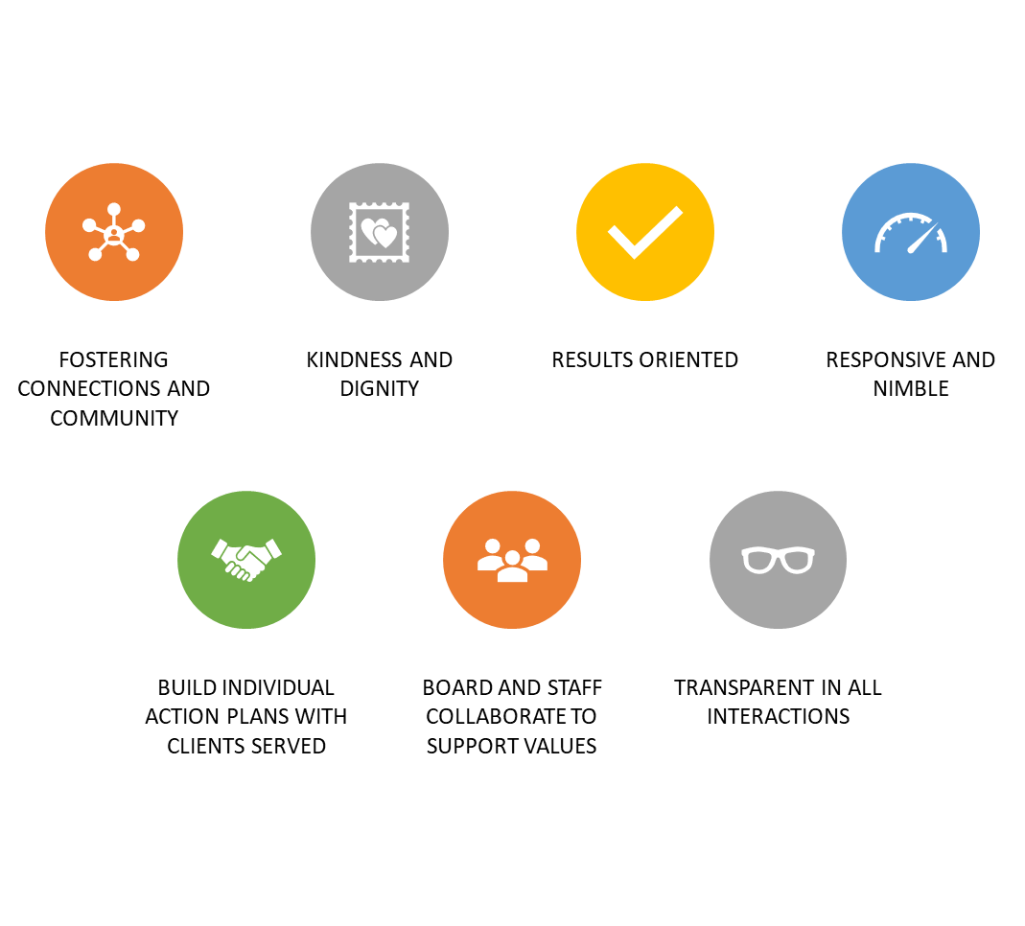
North Beach Citizens Values:
Trust, Integrity & Respect

Slide 3
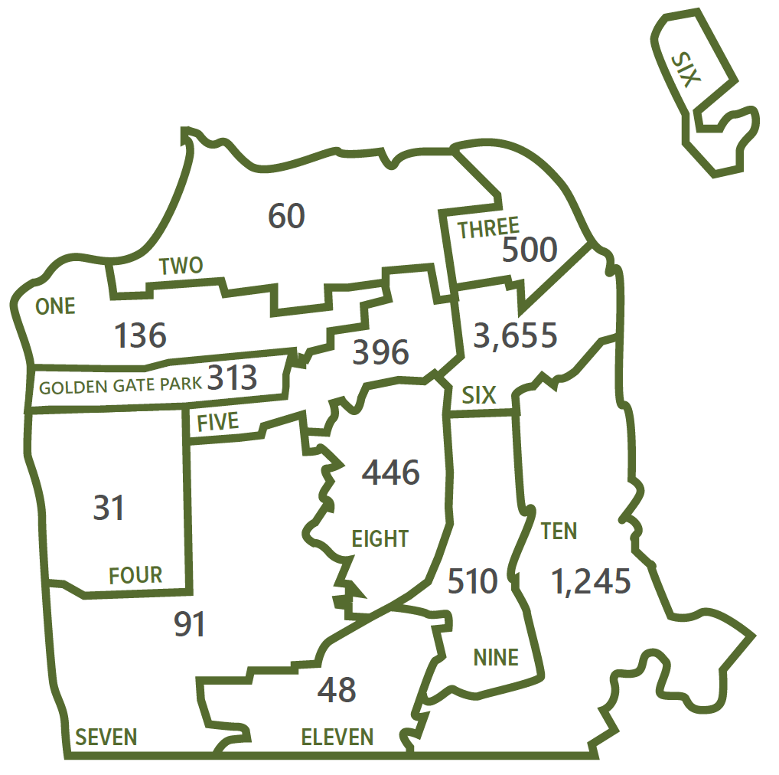
OVERVIEW STATISTICS
NORTH BEACH CITIZENS
According to San Francisco’s 2017 Homeless Count, District 3 has approximately 500 homeless individuals
This year, North Beach Citizens helped 575 individuals
53% of our clients accessed North Beach Citizens for the first time
10,485 meals were provided at our drop-in center
85,095 lbs of food distributed through our Community Food Pantry
4,450 bags of trash collected by our Street Beautification Team
* All NBC data is as of June 1, 2020
Source: Applied Survey Research. (2013-2017). San Francisco Homeless Count. Watsonville, CA.

Slide 4
NORTH BEACH CITIZENS CLIENT DEMOGRAPHICS
Gender
Race & Ethnicity
North Beach Citizens has consistently served a similar demographic. SF Consensus reports 53% White, 35.9% Asian, and 5.5% African American.

Slide 5
CLIENT DEMOGRAPHICS – AGE GROUP

Slide 6
Statistics of Clientele
27% - Substance Abuse Challenges
18% - Medical Disability
63% - Mental Health Challenges

Slide 7

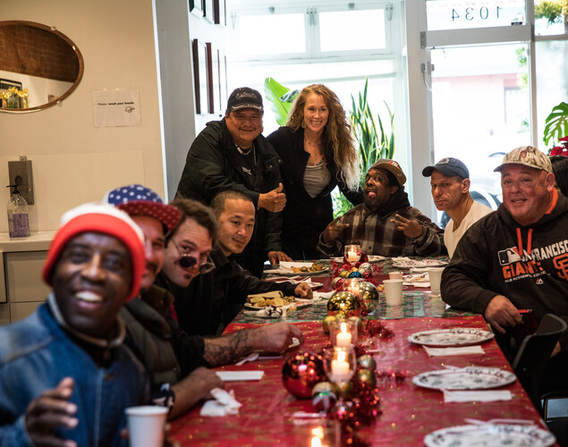
NBC-What can you do to make an impact?
Continue to provide crucial services to individuals in need
Educate others and dispel myths about causes of homelessness
Advocate for policy solutions in the city and state
Show your support for housing in our neighborhoods
Support North Beach Citizens financially and other like-minded causes
Call or get the 311 application on your phone when you see someone who needs help
Think creatively

